Slide 1

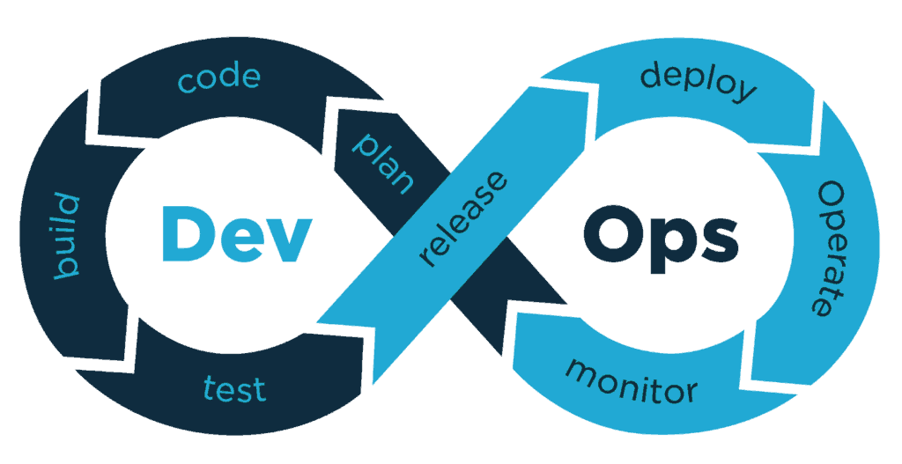
DevOps Practices
Continuous delivery of software-driven innovation

Slide 2
Contents
Definition
History
DevOps Architecture
DevOps Lifecycle
DevOps and Agile
Key DevOps Patterns and Practices
DevSecOps
DevOps and Cloud Integration
Toolchains

Slide 3
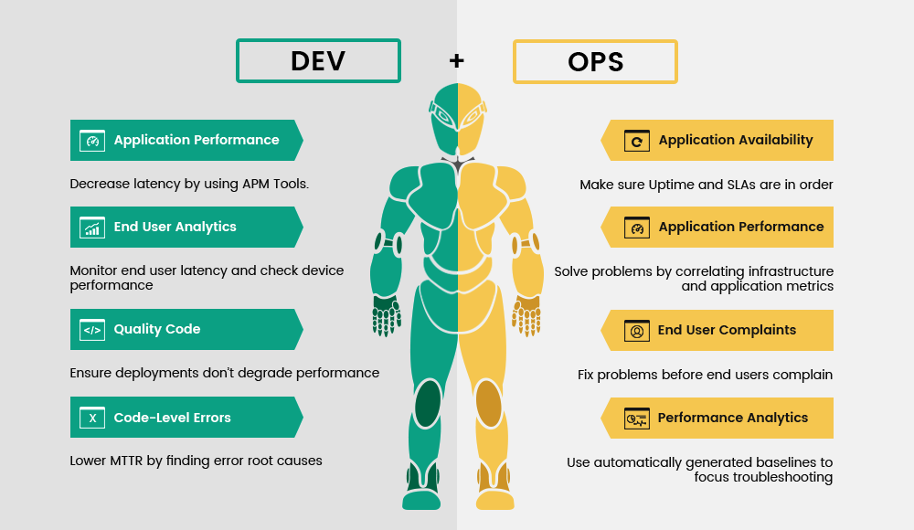
Definition
DevOps is a culture which promotes collaboration between Development and Operations Team to deploy code to production faster in an automated & repeatable way.
The word 'DevOps' is a combination of two words 'development' and 'operations.'

Slide 4
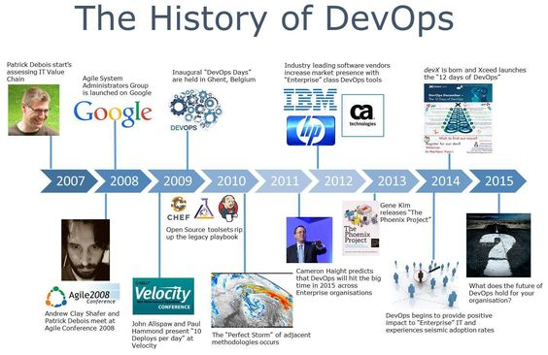

Slide 5
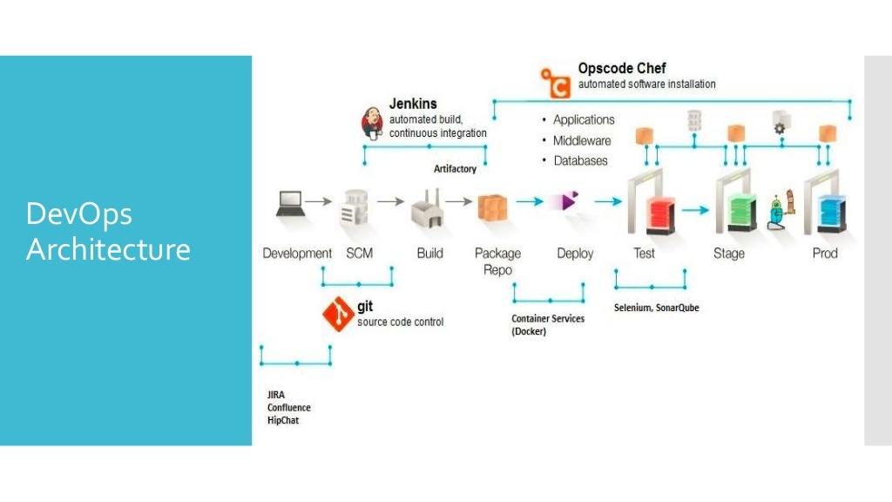

Slide 6
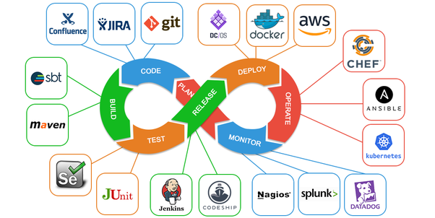
DevOps Lifecycle
The main principles of DevOps are automation, continuous delivery, and fast reaction to feedback.
DevOps pillars in the CAMS acronym:
Culture represented by human communication, technical processes, and tools
Automation of processes
Measurement of KPIs
Sharing feedback, best practices, and knowledge

Slide 7
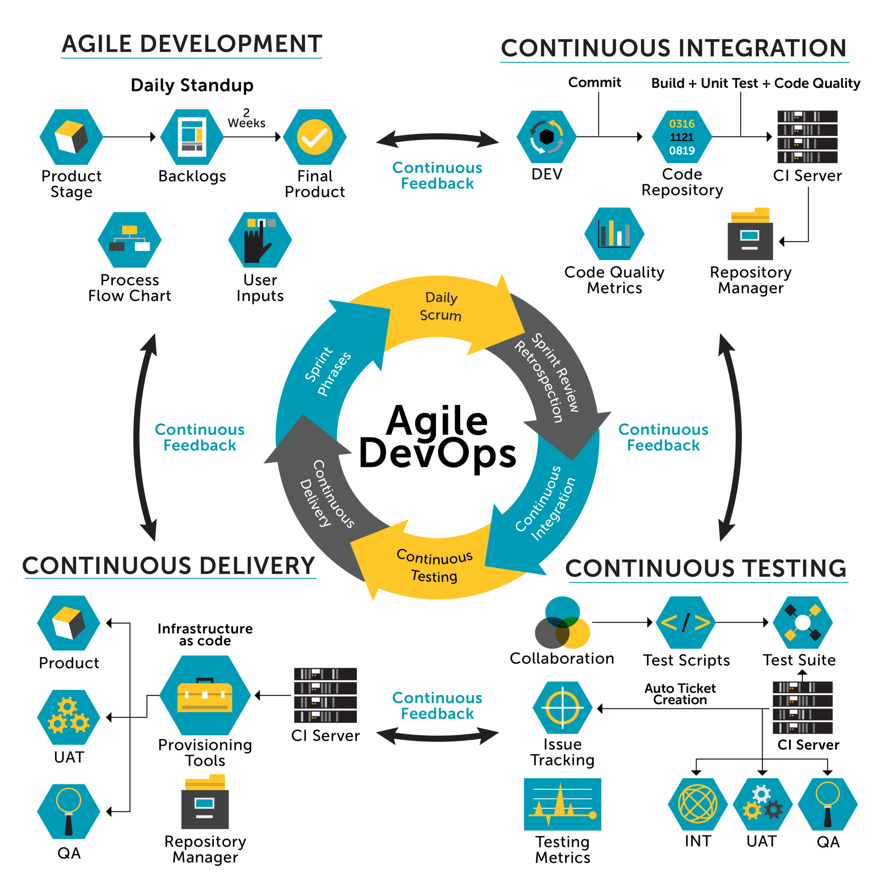
DevOps & Agile = Better Builds & Faster Releases
Though both the terms are broadly synonymous, it would be incorrect to say that they are both the same. - DevOps is the concept to manage end-to-end engineering processes, Agile is a process used to manage complex projects. - Agile is, in fact, one of the most essential parts of successful DevOps.

Slide 8
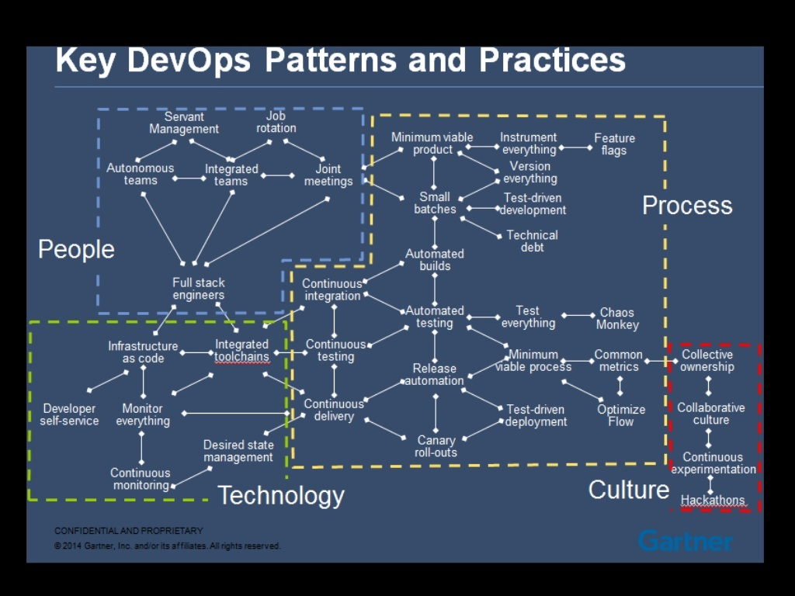

Slide 9
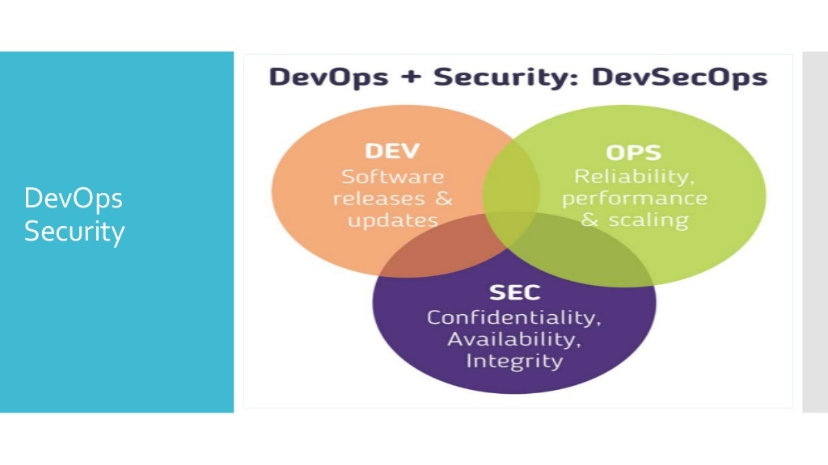

Slide 10
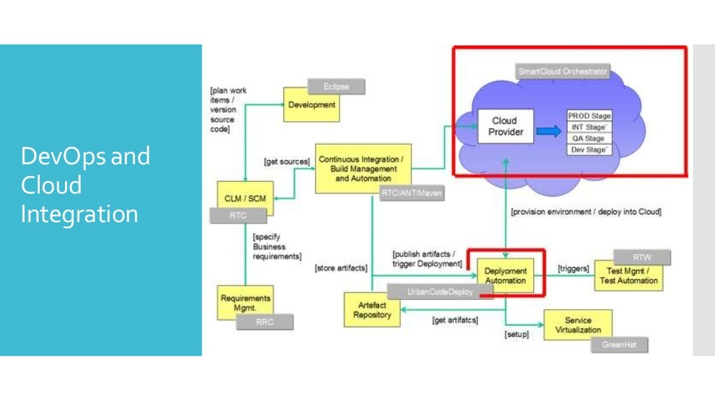

Slide 11
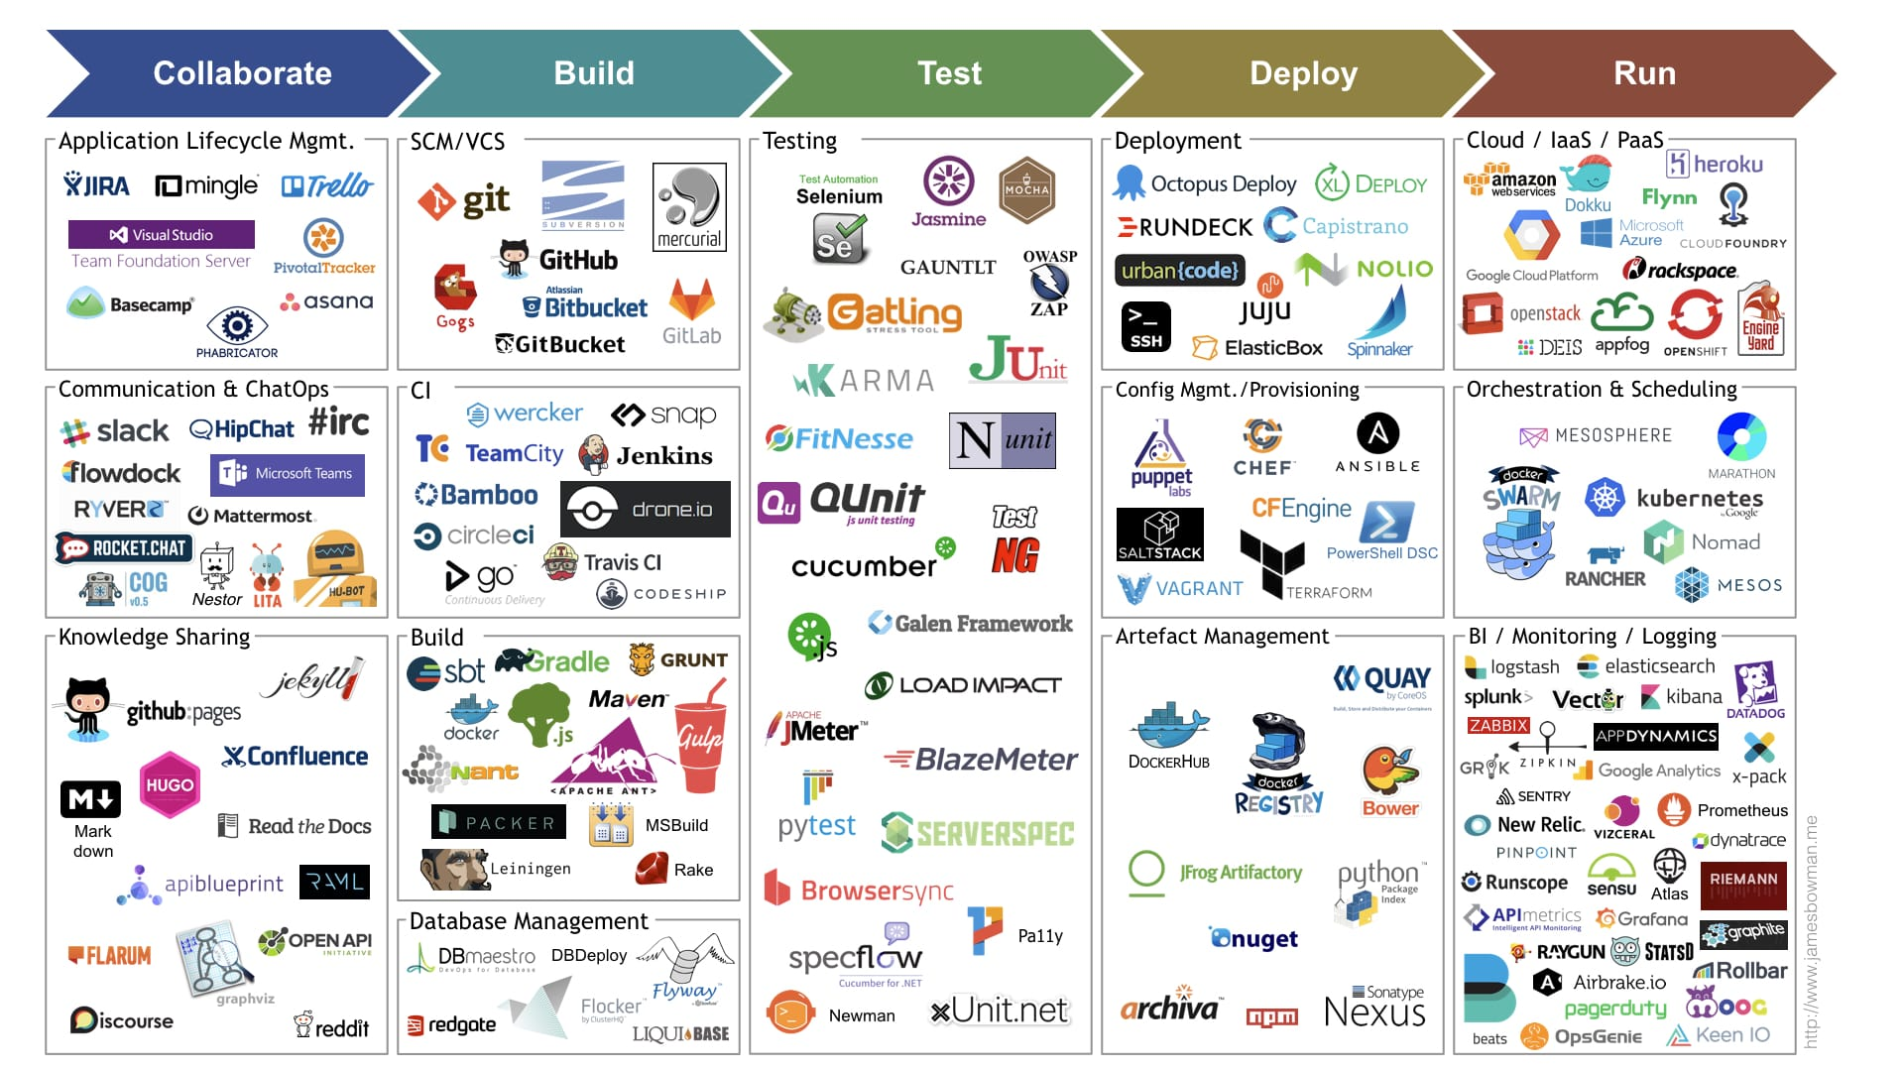
ToolChains

Slide 12
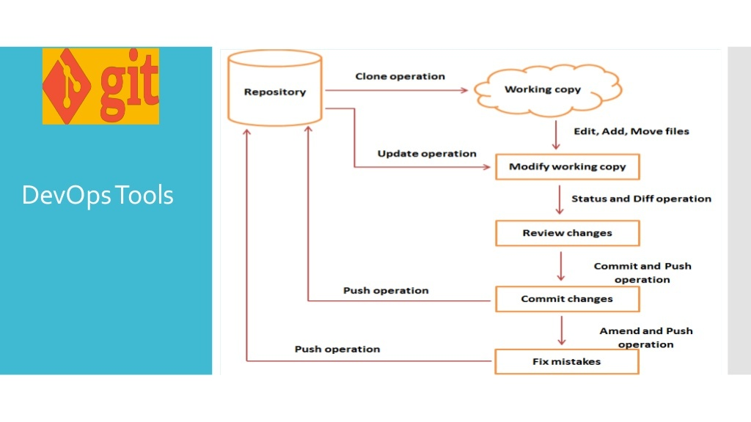

Slide 13
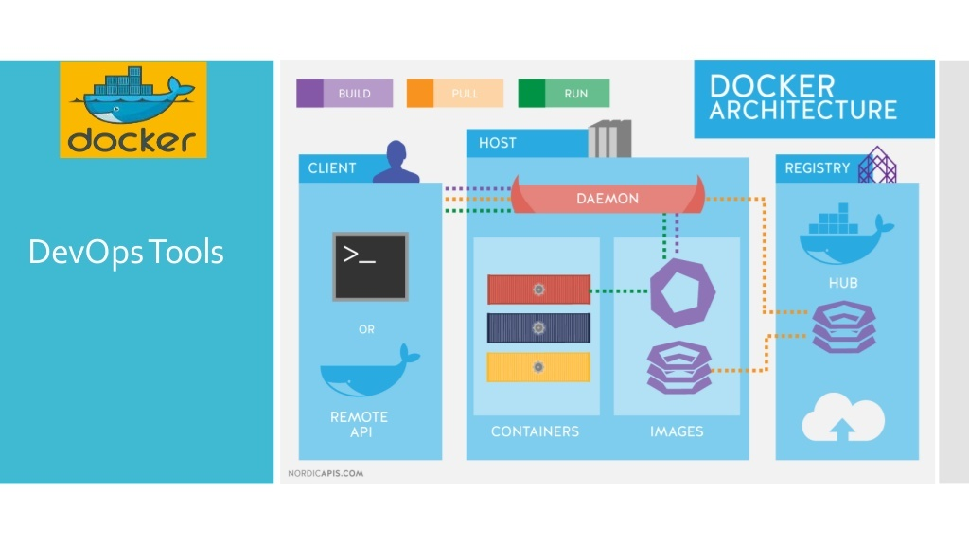

Slide 14
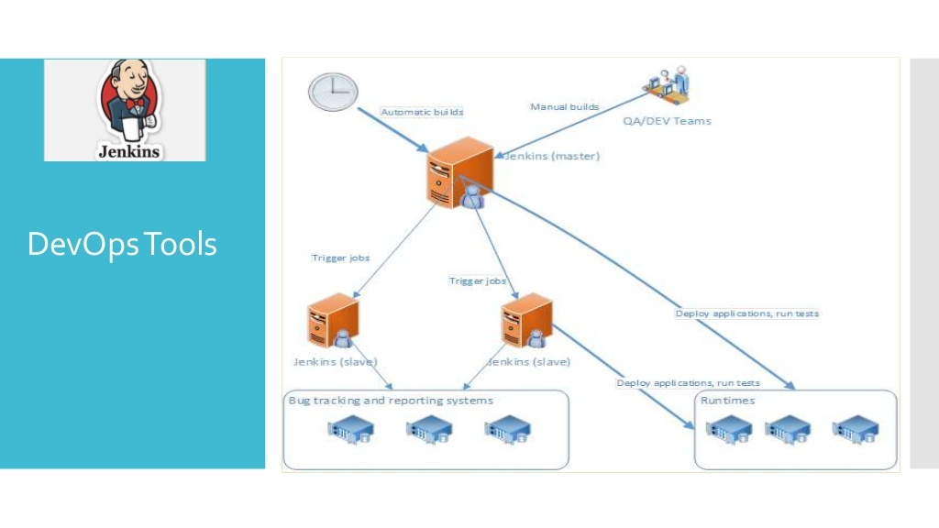

Slide 15
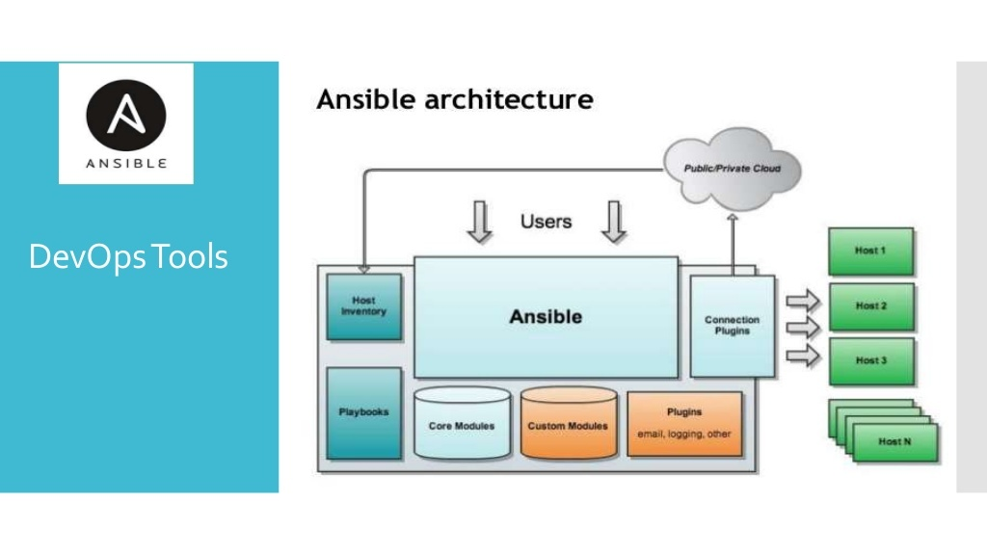

Slide 16
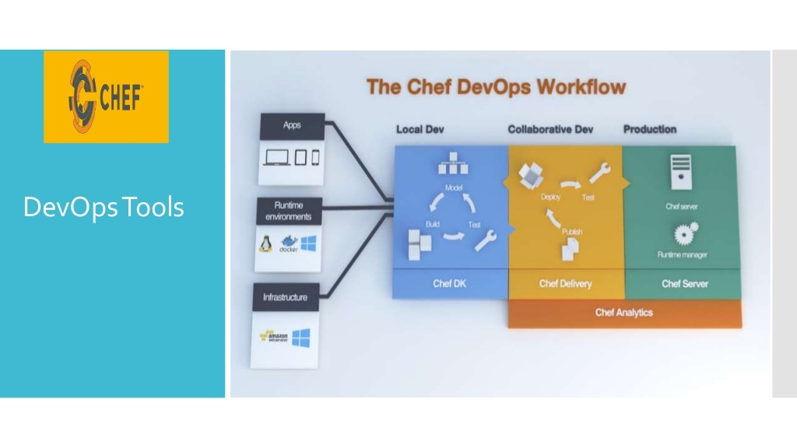

Slide 17
Thanks

